Slide 1

Welcome back!

Slide 2

English Language Arts / Grade 8
Mrs. King
Mrs. Moen
Room 141

Slide 3
Classroom Materials
Two composition notebooks-One for writing and one for literature and note-taking.
Loose leaf paper
Black or blue pen and/or pencils
A highlighter
Pocket folder
PLANNER!!!

Slide 4
The Course
Welcome!!! Welcome!!! Welcome!!!
Non-Fiction
Novels
Poetry
Essays/ Literary and Argumentative
Literary terms
Independent Reading projects.
NYS English Language Arts Exam/iReady

Slide 5
Class Room Etiquette
We raise our hands to contribute to class discussions.
We listen to each other when someone is speaking.
Respect the building, the property and the people who work here on your behalf.
Hall passes are available for your use to the girls or boys room. However…I ask you do this before class starts or at the end of class. You MUST sign out before leaving. We need as much class time as possible!

Slide 6
Each day…
Come to class on time.
Be respectful of your classmates.
Be prepared to start class each day with notebook and pen or pencil.
Notebooks will be checked on regular basis.
Homework will COUNT!
YOU are responsible for all assignments and points will be taken off for late work.
If you are ill, the guidance office can arrange for assignments to be sent home. Check my web site.

Slide 7
Monitoring your progress
Each day you will be asked to assess or review what you have done in class.
Behavioral issues will result in phone calls or meeting with your parents. We work together.

Slide 8
Now…a few more suggestions
Be curious
Ask questions if you are having difficulty.
Use after school help! I will be available for after school each Wednesdy and Thursday after school. You need to sign up with me ahead of time.
I can also be reached by email: claudia.king@wcsdny.org

Slide 9
One last thing
Be a leader ! Show kindness, consideration and thoughtfulness to others.
a positive influence!
a role model for others
Now….let’s get started!

Slide 10
Homework – Due Friday, September 13th
Code of conduct signed by yourself and your parents.
Course syllabus-Reviewed and signed by yourself and your parents.
Computer User Agreement signed and returned.
IF THERE ARE ANY QUESTIONS OR CONCERNS ABOUT SUPPLIES PLEASE LET ME KNOW!

Slide 11
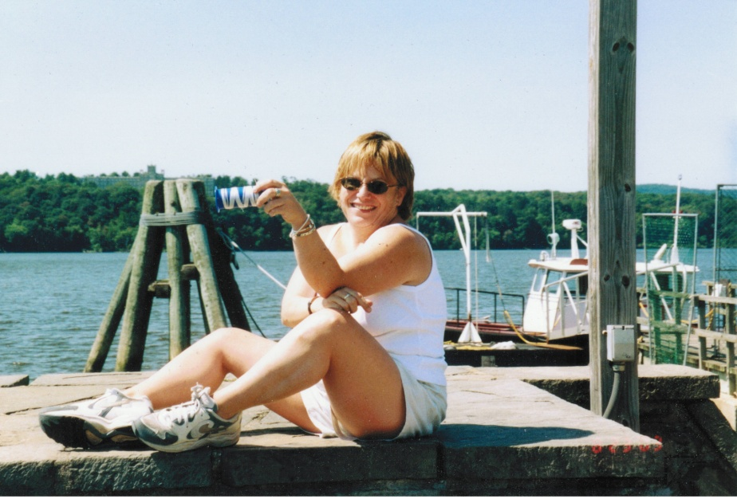
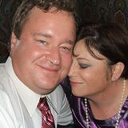
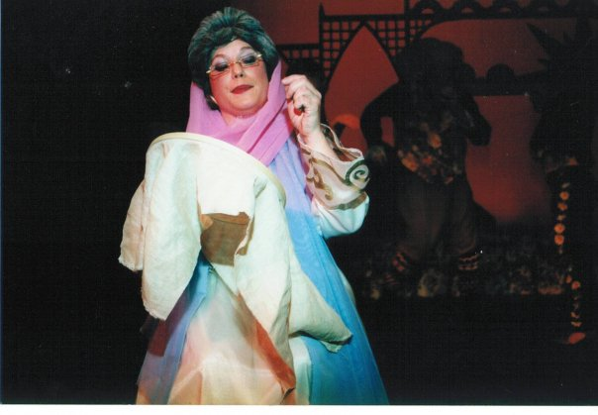
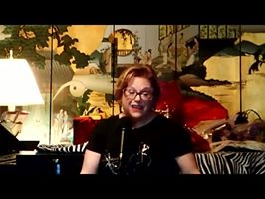
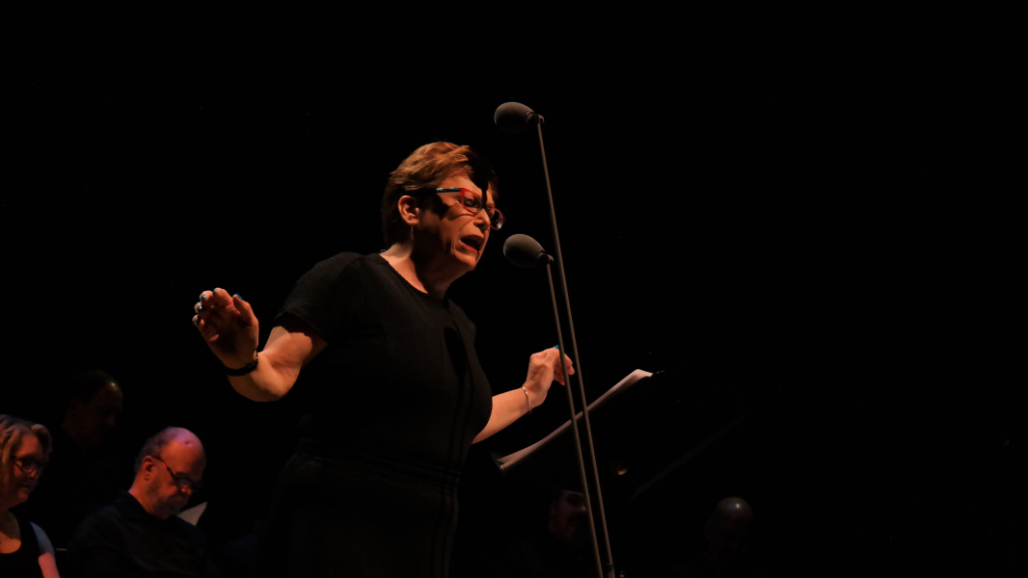
What I like to do!

Slide 12
A psychologist walked around a room while teaching stress management to an audience. As she raised a glass of water, everyone expected they'd be asked the "half empty or half full" question. Instead, with a smile on her face, she inquired: "How heavy is this glass of water?"
Answers called out ranged from 8 oz. to 20 oz.
She replied, "The absolute weight doesn't matter. It depends on how long I hold it. If I hold it for a minute, it's not a problem. If I hold it for an hour, I'll have an ache in my arm. If I hold it for a day, my arm will feel numb and paralyzed. In each case, the weight of the glass doesn't change, but the longer I hold it, the heavier it becomes."
She continued, "The stresses and worries in life are like that glass of water. Think about them for a while and nothing happens. Think about them a bit longer and they begin to hurt. And if you think about them all day long, you will feel paralyzed – incapable of doing anything."
Remember to put the glass down.

Slide 13
